Slide 1

Sequential Logic
CSE 4205 Digital Logic Design
Course Teacher: Md. Hamjajul Ashmafee
Lecturer, CSE, IUT
Email: ashmafee@iut-dhaka.edu

Slide 2
Remaining to Add
Review other books and internet resources
Notes:
What is digital computer? Examples where we can use this thing.

Slide 3
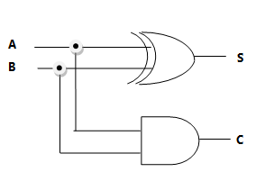
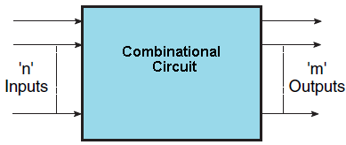
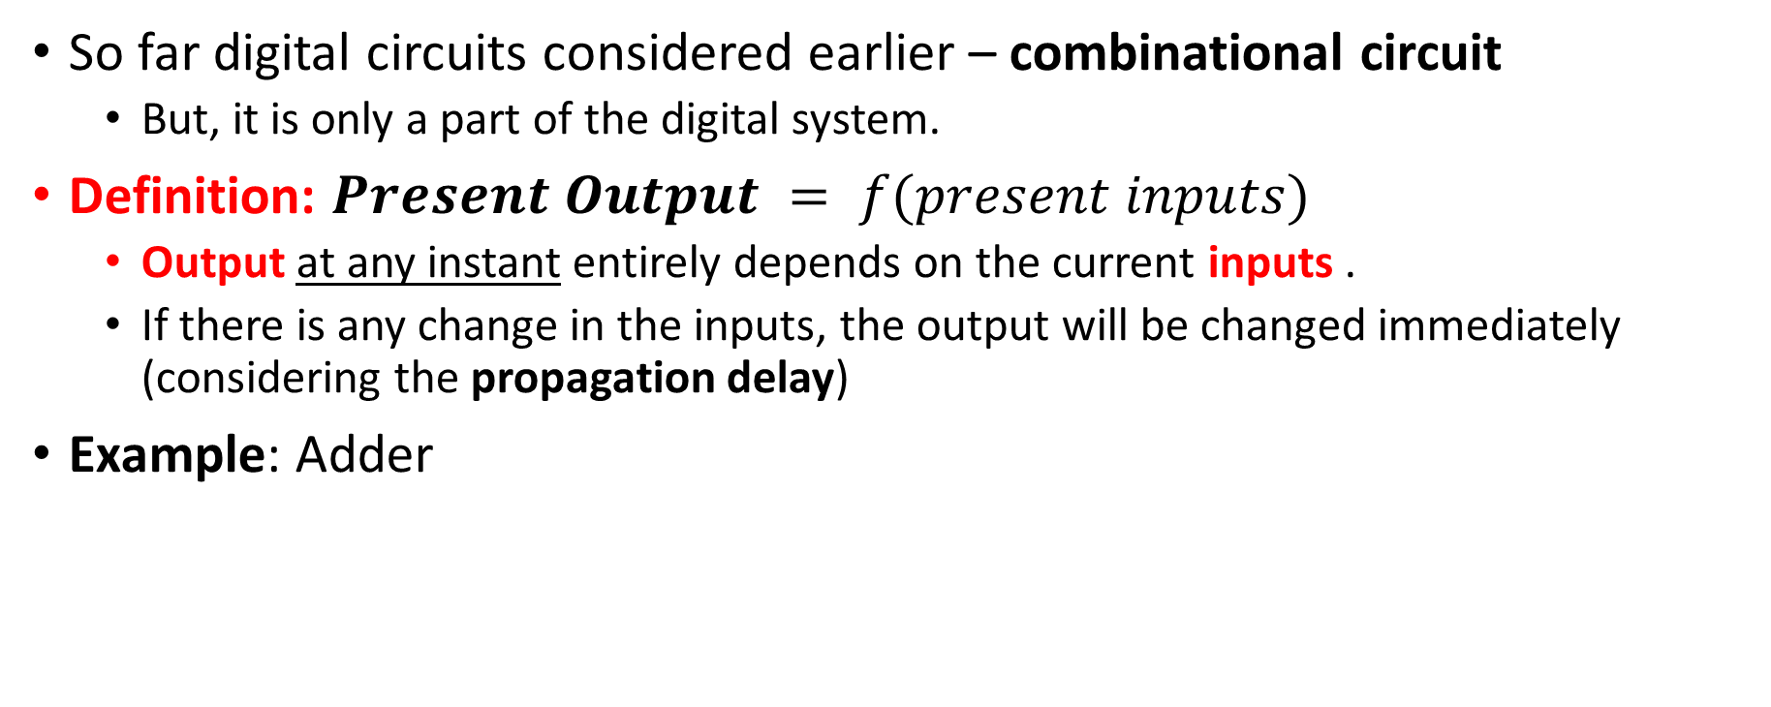
Introduction – Combinational Circuit
So far digital circuits considered earlier – combinational circuit
But, it is only a part of the digital system.
Definition: $Present Output = f(present inputs)$
Output at any instant entirely depends on the current inputs .
If there is any change in the inputs, the output will be changed immediately (considering the propagation delay)
Example: Adder

Slide 4

Introduction – Memory
Electronic devices nowadays have the ability to send, receive, store, retrieve and process information in binary format
It is only possible because of ability to store information (memory)
The circuits that include memory element called sequential circuit/logic
It is another major aspect of the digital system
But, design of sequential circuit depends on the combinational circuit design

Slide 5
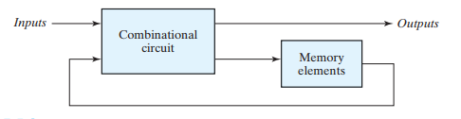
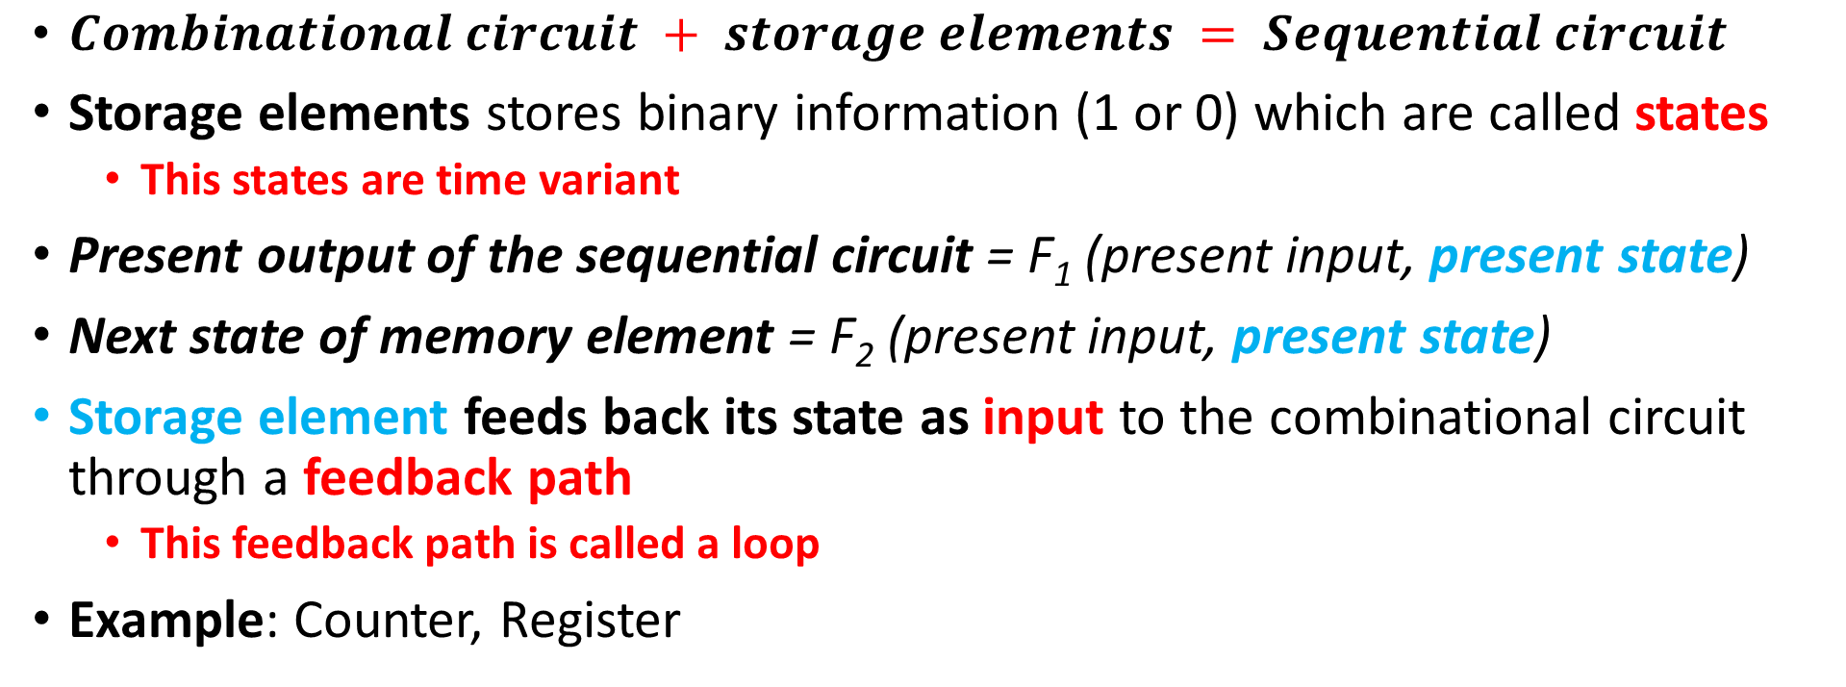
Sequential Circuit
$Combinational circuit + storage elements = Sequential circuit$
Storage elements stores binary information (1 or 0) which are called states
This states are time variant
Present output of the sequential circuit = F₁ (present input, present state)
Next state of memory element = F₂ (present input, present state)
Storage element feeds back its state as input to the combinational circuit through a feedback path
This feedback path is called a loop
Example: Counter, Register

Slide 6
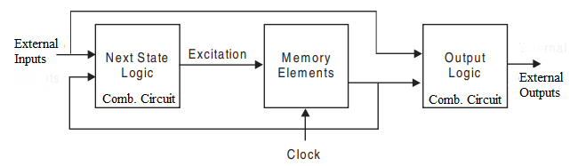


Sequential Circuit – A closer Look

Slide 7
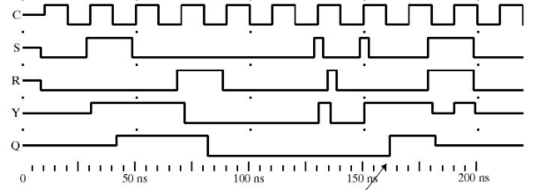
Time Sequence
Sequential circuit includes time sequence of inputs, outputs and internal memory states
This time-sequence determines the behavior of a sequential circuit.
Notes:
Here, S and R are inputs
Y is output
Q is the present memory state

Slide 8
Classification of Sequential Circuit
Two types of sequential circuit – based on timing of their input signal
Synchronous or clocked sequential circuit
Asynchronous or unclocked sequential circuit

Slide 9
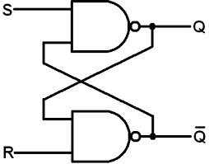
Asynchronous Sequential Circuit
Behavior defined based on the order/sequence of input signals at any instant of time
Only affected whenever the inputs change
No synchronization with clock pulse
Example: Latch
Time delayed memory element
Propagation delay is kept higher to provide storage attributes
Intentionally built with delay units
Drawback: unstable states at times due to some undesirable feedbacks
Advantage: faster than the synchronous sequential circuit

Slide 10
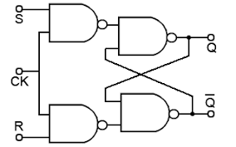
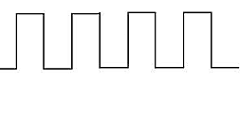
Synchronous Sequential Circuit
Behavior defined based on the input signals at discrete instants of time
Example: Flip-flop
Synchronization achieved through timing device
Also, known as system clock or master clock generator
It generates a periodic train of clock pulses
This clock pulse is ANDed with specific input signal
Clock pulse driven storage element
Only affected with arrival of each clock pulse
Clock pulse will define when changes will occur
External inputs will define what changes will occur
Advantages – eliminate instability problem
Common practice in electronic devises

Slide 11
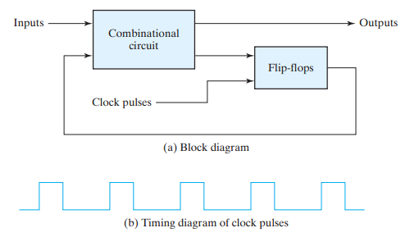
Clocked Sequential Circuit
Note: Here, the storage element is a flip-flop

Slide 12
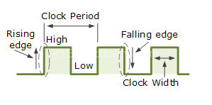
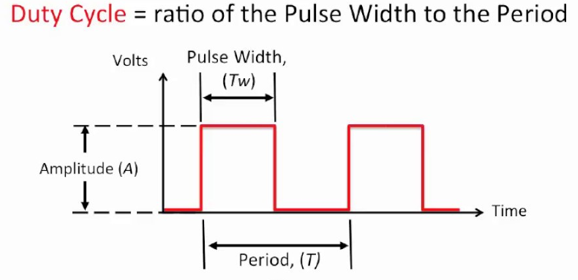
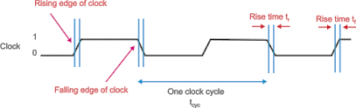
Clock
T_{w} = pulse duration

Slide 13
Flip-flops
Memory elements in clocked sequential circuit
A binary/digital memory cell that stores one bit of information
Number of inputs – One or more
Two outputs – normal (Q) and complement (Q’) value of the bit stored
Q=1, Q’=0 : set (1) state and Q=0, Q’=1 : reset (0) state
Q and Q’ can’t be same state at a time
If it happens, it goes to undefined state
Also known as a bistable multivibrator
Notes:
Bistable = stable in either states (0 and 1)
Multivibrator = an electronic circuit which is used to implement a simple two state system

Slide 14
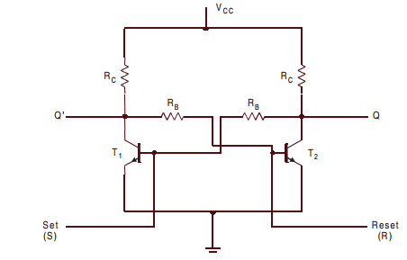

Flip-flops…
Block diagram of a flip-flop
Bistable Multivibrator Circuit

Slide 15
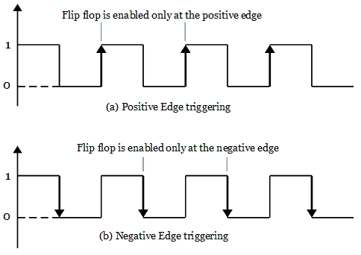
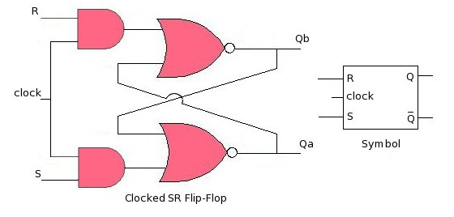
Flip-flops…
Implemented with NAND or NOR gates
Differences in types of flip-flops:
Based on number of inputs and the manner in which the inputs affect the binary state
Edge triggered device

Slide 16
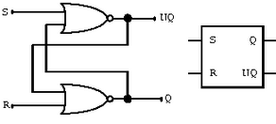
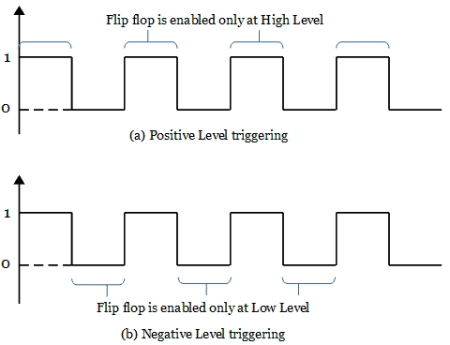
Latch
It has two stable states
Used to store binary information
Binary memory element
Latches are basic storage elements that operate with signal levels (rather than signal transitions).
Level triggered device
It is not synchronized with clock pulses

Slide 17
Latch vs Flip-flop
The state of flip-flop changes at active state of clock pulses and remains unaffected when the clock pulse is not active.
It serves as a memory element in synchronous sequential circuits
It is applied with clock pulses
In particular, the unclocked flip-flops (i.e., latches) changes its states of the output immediately based on the applied input
It serves as memory elements in asynchronous sequential circuits.
Sometimes it is applied enable input

Slide 18
Types of Flip-flops
Based on how the inputs and clock pulses cause transition between two states:
S-R (Set-Reset) flip-flop
D (Data) flip-flop
J-K (J: set, K: reset) flip-flop
T (Toggle) flip-flop

Slide 19
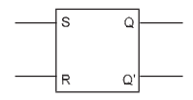
S-R (Set-Reset) flip-flop
Two inputs – Set (S) and Reset (R)
Two outputs – Q and Q’ (complement to each other)
Made of cross-coupled connection from output to input constituting a feedback path

Slide 20
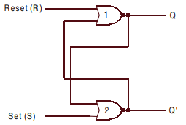
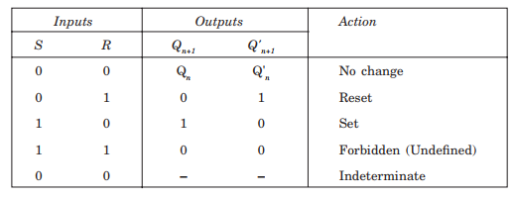
S-R (Set-Reset) Latch – with NOR Gates Level triggered device
Not clocked or synchronized
Level triggered
Asynchronous sequential circuit
(Memory state)
(Reset state)
(Set state)
(after an undefined occurrence)
Note: The output of a NOR gate is zero (0) if any of the inputs are 1, irrespective of the other input.
Notes:
Discuss all cases from the truth table
Start with S=0 and R=0. It considers both cases of Q (0 and 1). It results in memory state
Then, S=0 and S=1 (second and third cases). Here we will not consider Q. Because, inputs themselves force to change the Q.
S (input) and Q (output) should be in opposite direction/level for with NOR gates
Last occurrence from the truth table is only possible, if its previous state was undefined. After that if the state is S=0 and R=0, the output, Q totally depends on speed of the NOR gate (which NOR gate will be 0 at first)

Slide 21
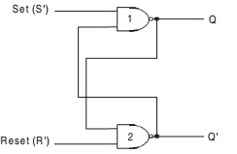
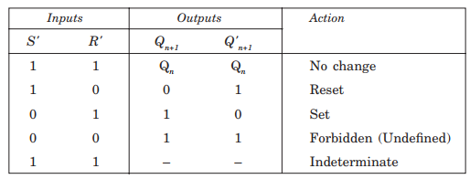
S’-R’ Latch – with NAND Gates Level triggered device
Also, not clocked or synchronized
Level triggered and asynchronous sequential circuit
Operationally similar as NOR based S-R flip-flop
(Memory state)
(Reset state)
(Set state)
(after an undefined state)
Note: The output of a NAND gate is one (1) if any of the inputs are 0, irrespective of the other input.
Notes:
It is called S’-R’ because, S’ and R’ with NAND gates is similar to S and R with NOR gates. It can be verified from the truth table mentioned above.
But, they, both are same in operation with S and R inputs which can be justified from the truth table
Discuss all cases from the truth table
S (input) and Q (output) should be in same direction/level for with NAND gates
Last occurrence from the truth table is only possible, if its previous state was undefined. After that if the state is S=0 and R=0, the output, Q totally depends on speed of the NAND gate (which NAND gate will be 1 at first)

Slide 22
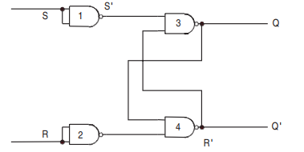
Comparing S-R and S’-R’ Latch
They just operate in a complement fashion of each other
To convert a NAND-based S’-R’ latch to NOR-based S-R latch, an inverter at each input of the latch should be placed
This change will make the truth tables and circuits similar
Notes:
It is called S’-R’ because, S’ and R’ with NAND gates is similar to S and R with NOR gates. It can be verified from the truth table mentioned above.
But, they, both are same in operation with S and R inputs

Slide 23
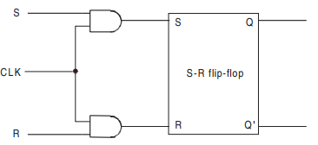
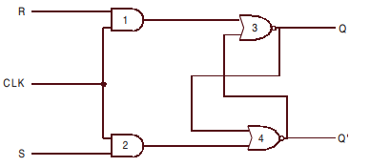
Clocked S-R Flip-Flop
Synchronous circuit
Activated during a clock pulse is present
From a latch, a flip-flop can be produced including an additional input to control the behavior of the circuit
latch
Notes:
If clock=0, both AND gates produce 0 and 0 in the inputs of S and R which in turn keeps the latch in memory state
If the clock=1, the changes in S and R will be passed and change the Q (output).
S and Q should be in opposite direction/level for with NOR gates

Slide 24
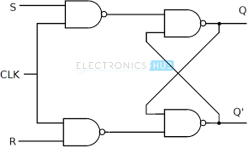
Clocked S’-R’ Flip-Flop
Constructed with NAND gates
S’-R’ latch
S-R Flip-Flop
Notes:
If clock=0, both NAND gates produce 1 and 1 in the inputs of S and R which in turn keeps the latch in memory state
If the clock=1, the changes in S and R will be passed and change the Q (output).
This complete circuit works as a S- R flip-flop considering same inputs for S and R

Slide 25
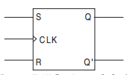
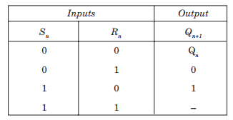
S-R Flip-Flop [Final version]
Logic symbol and truth table
Three inputs – S, R and CLK
The clock input is marked with a triangle denoting edge triggered flip-flop
Q_{n} denotes output at n^{th} time and Q_{n+1} denotes output at (n+1)^{th} time

Slide 26
Characteristic Table and Truth Table
Characteristic table and truth table:
Truth table with present input(s) and present state(s) as input column and next state(s) as output column refers to a characteristic table
It refers to the operational characteristics of the flip-flop

Slide 27
S-R Flip-Flop - Characteristic table
Characteristic table and Characteristic equation of S-R flip flop
From book [page 224-225]

Slide 28
Preset and Clear Inputs
Initially, a circuit is uncertain with Q and Q’ states
They should be assigned with either set or reset state with direct or asynchronous inputs
Also, called as overriding inputs
These inputs are individually named as preset (Pr) and clear (Cr)
These inputs are not synchronized with clock
They can be applied at any time
CLK = 0 or 1, doesn’t care at all [but, preferred to be applied when clock is inactive]
Pr=0 and Cr=0 must not be applied, as it leads to an uncertain state
Pr and Cr inputs are used with bubbles considering them active low

Slide 29
Preset and Clear Inputs…
More from book [page 223-224]
Preset and clear inputs with S-R flip-flop
Block diagram of an S-R flip-flop with preset and clear inputs
Truth table with preset and clear inputs

Slide 30
D Flip-Flop From Book [page 225-227]
Derivation from S-R flip-flop
Truth table and all cases of D flip-flop
Block diagram of D flip-flop
D flip-flop with Pr and Cr inputs
Characteristic table and equation of D flip-flop

Slide 31
J-K Flip-Flop
Very similar to an S-R flip-flop
J and K behave like inputs S and R to set and reset the flip-flop
Only difference is eliminating the undefined condition of an S-R flip-flop
When J=K=1, the flip-flop is said to be in a toggle state
Toggling means complementing the state in each clock pulse

Slide 32
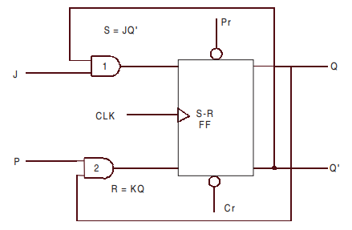
J-K Flip-Flop – Implementation
Implementation from S-R flip flop
Another level of feedback path is included
Inputs J and K of J-K flip-flop are ANDed with Q’ and Q respectively to obtain the inputs, S and R for S-R flip-flop

Slide 33
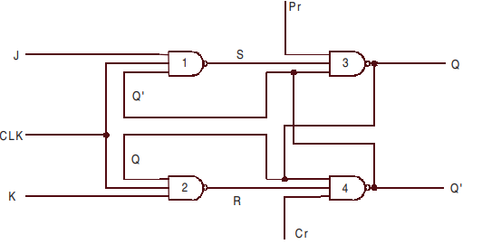
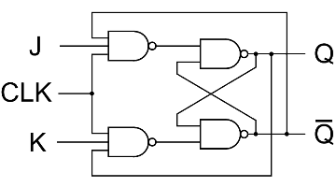
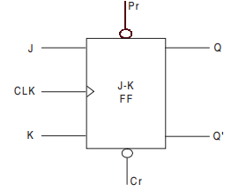
J-K Flip-Flop – Implementation…
Circuit diagram and block diagram of a J-K flip flop with NAND gates
Same circuit diagram in different orientation

Slide 34
J-K Flip-Flop – Truth Table
Truth table of J-K flip-flop – From book [page-230]
J-K inputs with S-R inputs of S-R flip-flop to derive the next state
It is assumed that inputs will not be changed any more during a clock pulse
Concise truth table (final version) for J-K flip-flop

Slide 35
J-K Flip-Flop – Characteristic Table
Characteristic table and characteristic equation for J-K flip-flop
More from book [page 231]

Slide 36
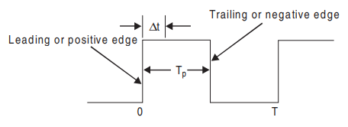
J-K Flip-Flop – Race Around Condition
Assumption for basic J-K flip-flop:
The inputs will not be changed any more during a clock pulse
But, it is not true because of the feedback connections
Consider the scenario: J=K=1
If Q=1, after △t time, it will be Q=0
Next, if Q=0, after another △t time, it will be Q=1
So, basically, during t_{p} time, the output Q will oscillate between 0 and 1
And, after t_{p} time, the output Q is not certain.
This situation is called “Race-Around Condition”
△t = propagation delay
t_{p} = pulse duration

Slide 37
Race Around Condition – Solutions
If △t is in nanoseconds and t_{p} in microseconds, output will be changed thousands of times within a clock pulse
If t_{p} < △t < T, this race around condition could be avoided
But, this small propagation delay is very difficult to achieve due to hardware limitation
Master-Slave (M-S) flip-flop
Edge triggered flip-flop

Slide 38
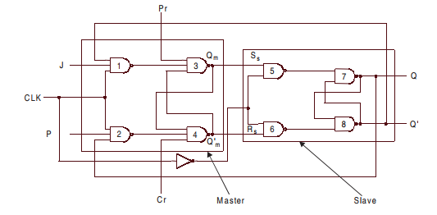
Race Around Condition – Master-Slave J-K Flip-Flop
A system of two flip-flops – master and slave flip-flops
A clock pulse is applied to master and the inverted form of the same clock is applied to the slave
How to solve RAC problem?
When CLK=1, gates 5 and 6 will not respond. Output Q and Q’ will only change when CLK=0.
K

Slide 39
Master-Slave J-K Flip-Flop…
When CLK=1, the master is enabled. Q_{m} output will respond the inputs J and K
Slave is disabled
When CLK=0, the slave is enabled. Q output will respond the outputs Q_{m} and Q’_{m}
Master is disabled
K

Slide 40
Master-Slave Flip-Flop – More
The system of M-S flip-flop is not restricted to J-K M-S flip-flop only
Also, S-R and D M-S flip-flops are possible
In all of these cases, the slave is an S-R flip-flop whereas the master changes to J-K, S-R or D flip-flops

Slide 41
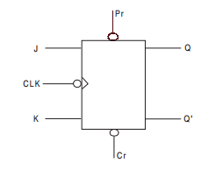
Race Around Condition – Edge Triggered Flip-Flop
The circuit has only single chance to accept inputs (e.g., J and K)
During:
Negative transition of the clock pulse – negative edge triggered J-K flip-flop
Outputs are same M-S flip-flop
Positive transition of the clock pulse – positive edge triggered J-K flip-flop

Slide 42
T Flip-Flop
A slight modification of the J-K flip-flop
J and K inputs are tied together – have same input
Referred as T flip-flop
It has the ability to toggle
One input (T) and two outputs Q and Q’
Two states – toggle (T=1) and memory (T=0) states
Usage: Counter, switching circuits

Slide 43
T Flip-Flop From Book [page 233-235]
Truth table of T flip-flop
Try all cases
T flip-flop with preset and clear inputs
Block diagram of T flip-flop
Also, from J-K flip-flop
Characteristic table and characteristic equation

Slide 44
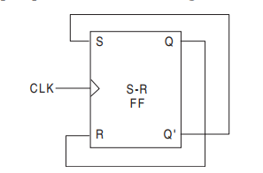
Toggle Mode – S-R flip-flop
Outputs (Q and Q’) are cross-coupled with inputs (S and R)
Here, S=R=1 is not possible to be applied, as it is an undefined state

Slide 45
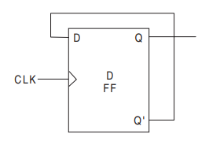
Toggle Mode – D flip-flop
Output Q’ is cross-coupled with input D

Slide 46
Triggering of Flip-flops
Level Triggering
Edge Triggering

Slide 47
Excitation Table
A tabulation to figure out all possible input conditions to obtain the desired output condition
It is required to design a sequential circuit when present state and next state of the flip-flop is specified
Based on that we need to find out all possible input conditions
Present and next states are meant the conditions before and after applying the clock pulse respectively

Slide 48
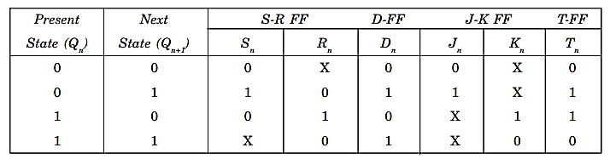
Excitation Table of all Flip-Flops

Slide 49
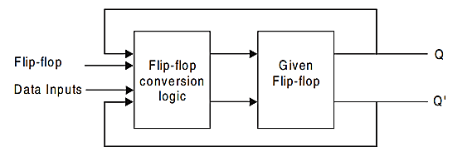
Interconversion of Flip-flops
A conversion logic is required to be designed for such conversions of flip-flops
Steps:
Produce the characteristic table of the required Flip-flop
Produce the excitation table of the given Flip-flop
Combine those tables make a final table including data input(s) of desired flip-flop and Q as the inputs and the input(s) of the given flip-flop as the outputs
Desired

Slide 50
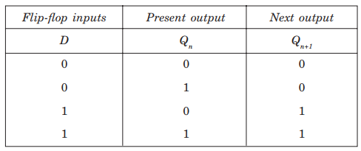
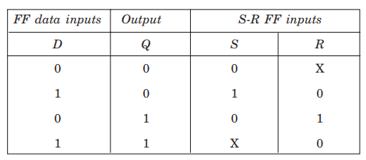
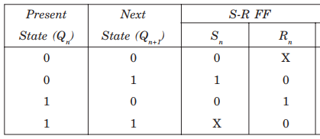
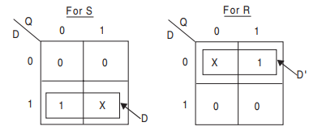

Interconversion of Flip-flops: Example
Example: From an S-R flip-flop to a D flip-flop
From Book [page 241-247]
Step 1:
Step 3:
Step 2:
$$S= D$$
$$R=D’$$

Slide 51
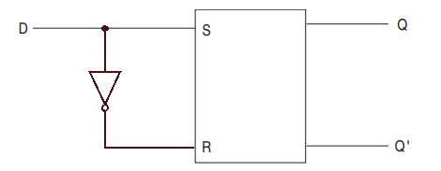
Interconversion of Flip-flops: Example …
Converted Flip-flop:

